Slide 1

Project Topic:-
Online Job Portal
Online project based
on Python with django
Notes:
oo

Slide 2
OBJECTIVES
Statement of the problem
Proposed system
Overview
Tools & Technology
Expected Outcome

Slide 3
Introduction of Project
It is a platform to search job online.
Students search their job on his/her profile.
Recruiter and admin job and user, they add job for users.
Admin manage recruiters and users to add job, information and apply for job.
We are using HTML, CSS, Bootstrap and JS for front-end design.
Django use for backend in this project.
SqLite database used in this project.

Slide 4
Minimum Software and Hardware Specification:-
Pentium IV Processor
512 MB RAM
40 GB HDD
Color Monitor
Keyboard, Mouse
Python installed
Any text editor (Pycharm, notepad++, etc.)
Django installed
Any Internet Browser

Slide 5
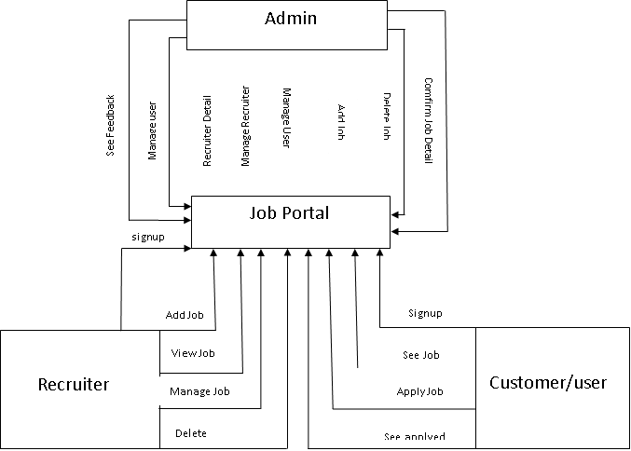
Data Flow Diagram (DFD) :-

Slide 6
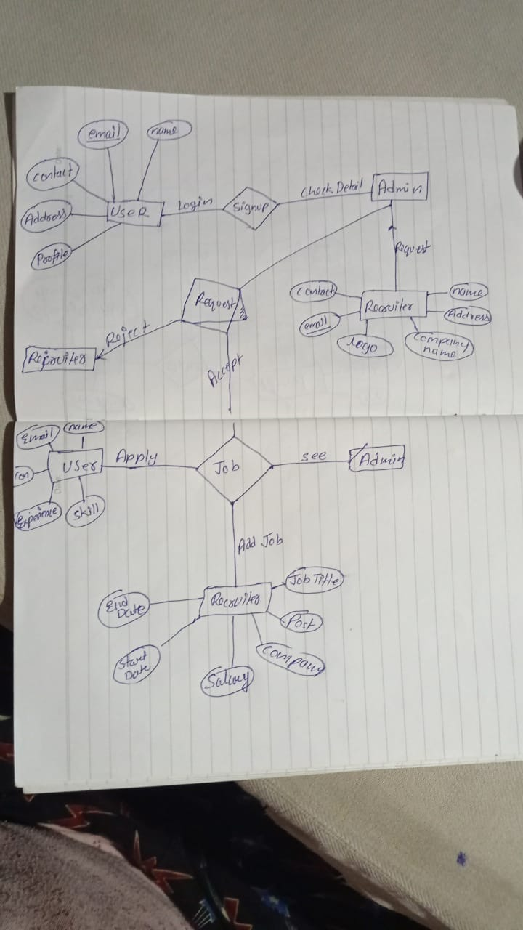
ENTITY RELATION DIAGRAMS (ER):-

Slide 7
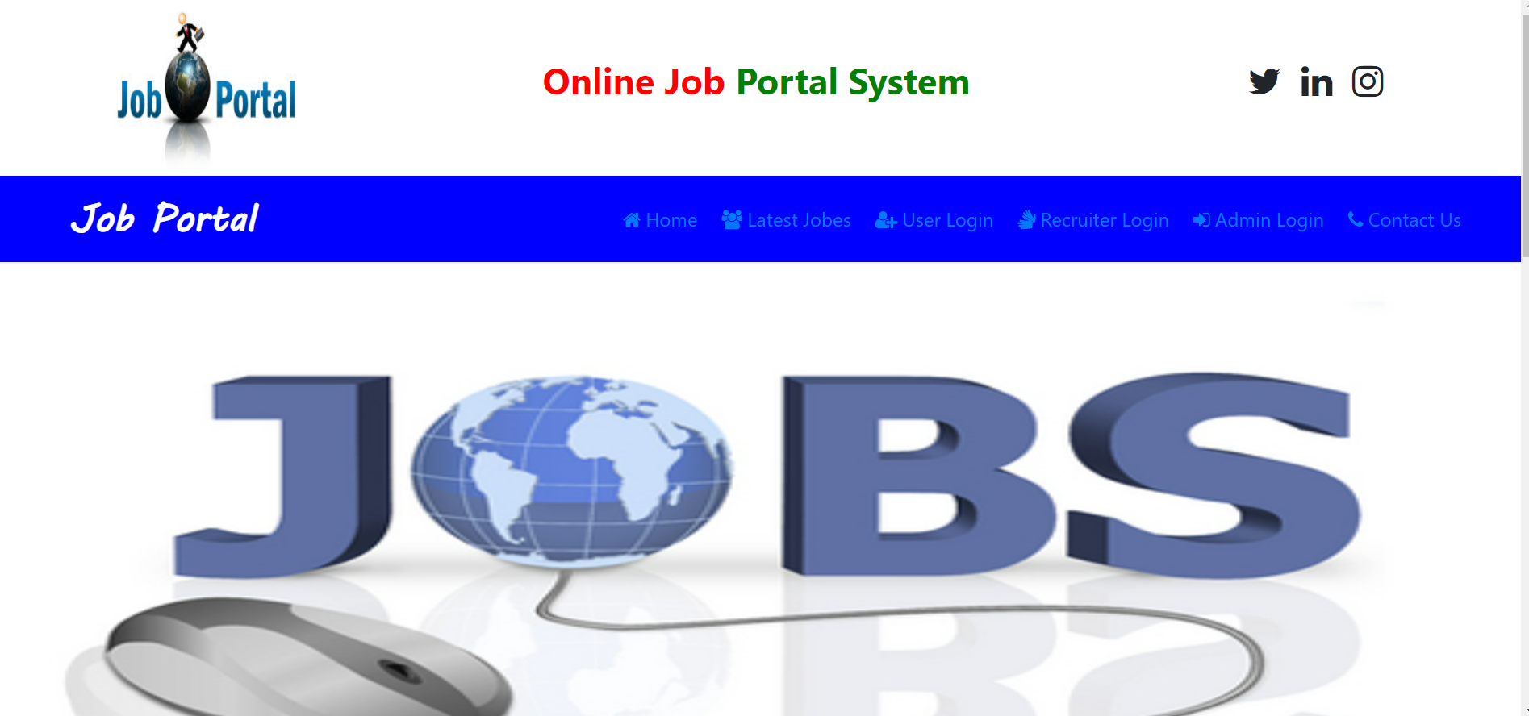
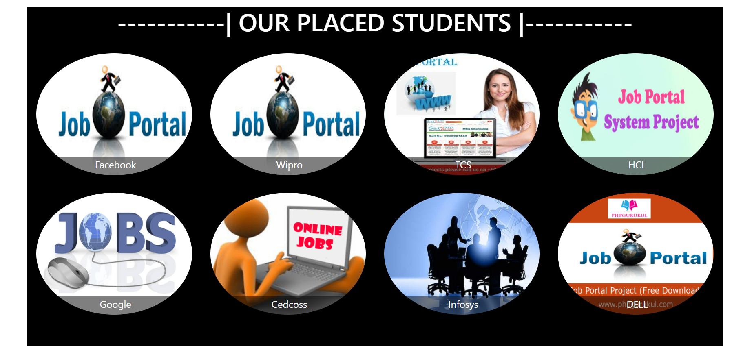
Home Window Of the Project:-

Slide 8
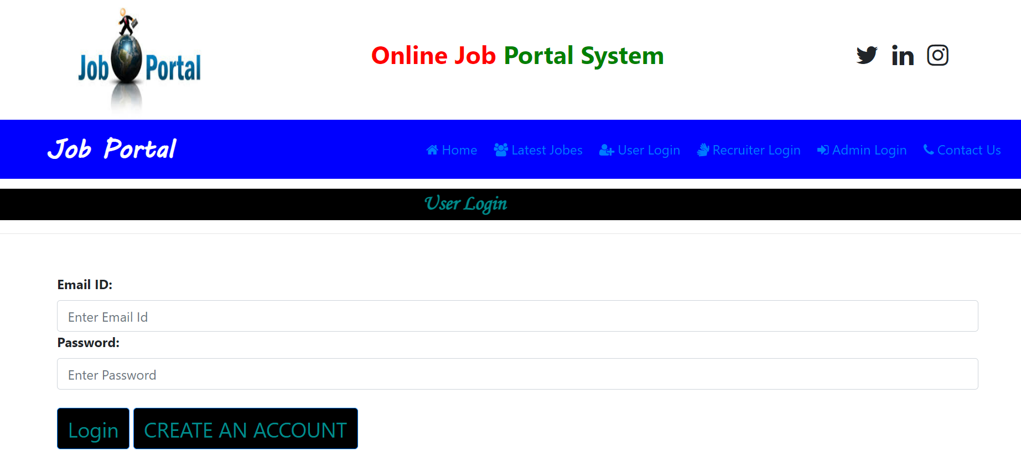
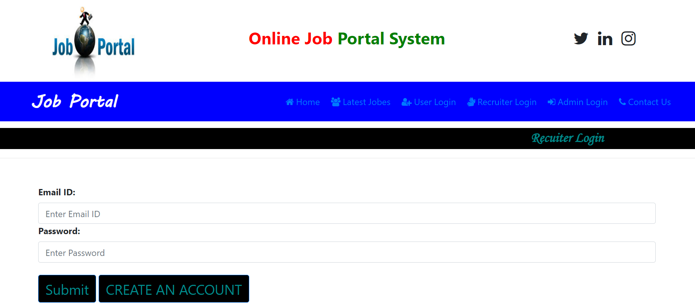
Login Window Of the Project:-

Slide 9
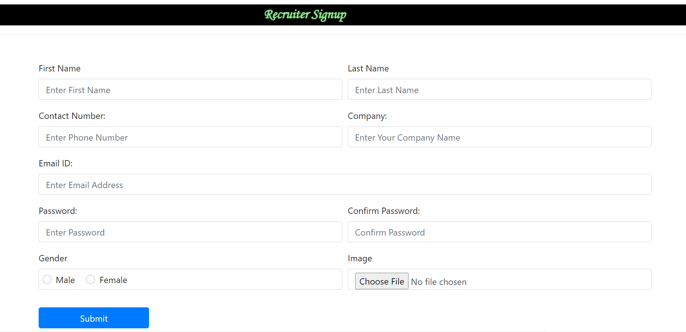
Signup Window Of the Project:-

Slide 10
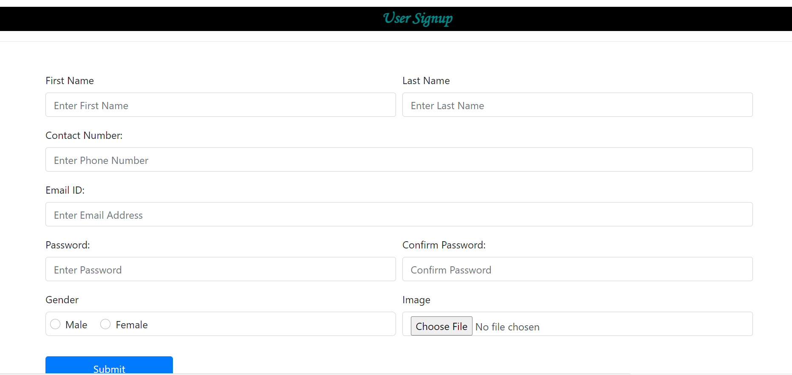
User signup PAGE :-

Slide 11
Advantages:-
Easy to find job online.
Find job at any time 24*7 hour.
Easy to check vacancy.
Apply for job by checking profile of job as they need to do job.

Slide 12
Disadvantages:-
Must have to a system or mobile.
Internet connection required.
Connection may loss dew to network problem.
Screen may harmful for eyes.

Slide 13
Thank You

